Slide 1




Few Shot Bioacoustic Event Detection in Freshwater Soundscapes
Authors: Felicia Huffman (1), Evan Lucas (1), Rosalyn Seddon (2)
(1) Computer science, MTU
(2) Centre for Environment Fisheries and Aquaculture Science
Student paper awards feedback

Slide 2
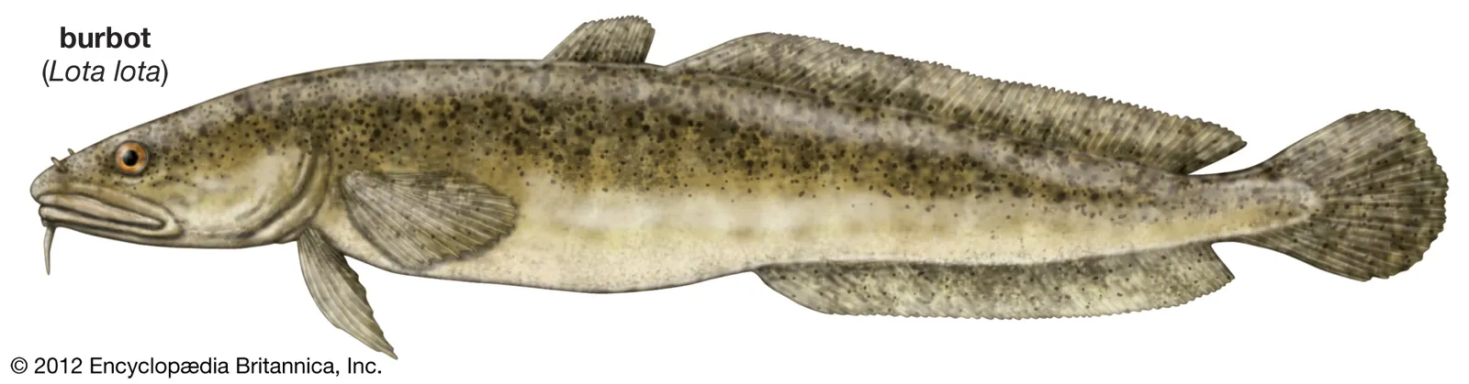
Background & Motivation
Underwater Bioacoustics has been researched extensively in marine soundscapes, but not as much in freshwater
Contributing to documentation of acoustic fish communication and the impact of anthropogenic noise on communication is important
Burbot vocalize, potentially during spawning, which offers opportunities for studying them using acoustics
Current event detection methods can be tedious and time consuming, creating a detector with a machine learning based classifier offers a more efficient, practical method

Slide 3
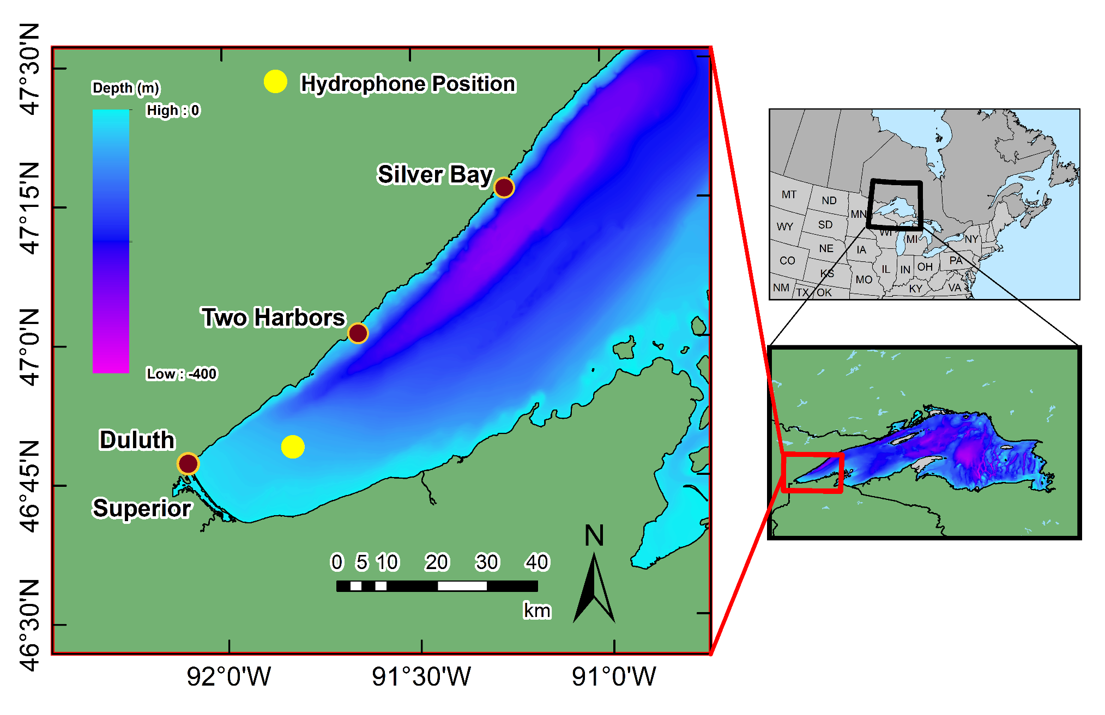
Data Collection
Collected in Duluth Minnesota by Dr. Rosalyn Seddon
Omni Directional ST300 Hydrophone - 10-72k Hz
• Sampled at 24k Hz, flat 3dB frequency response
X
X
Duty cycle - 2 minutes on/20 off
3 deployments - 2 winter, 1 summer
Total of 15 months in Nov 2018- March 2020
Hydrophone Position in Lake Superior (X)
Labeled manually via visual inspection
5 unique events identified, 1-20 examples each
⚠ Big Assumption: Our labeled data is fully correct and complete

Slide 4
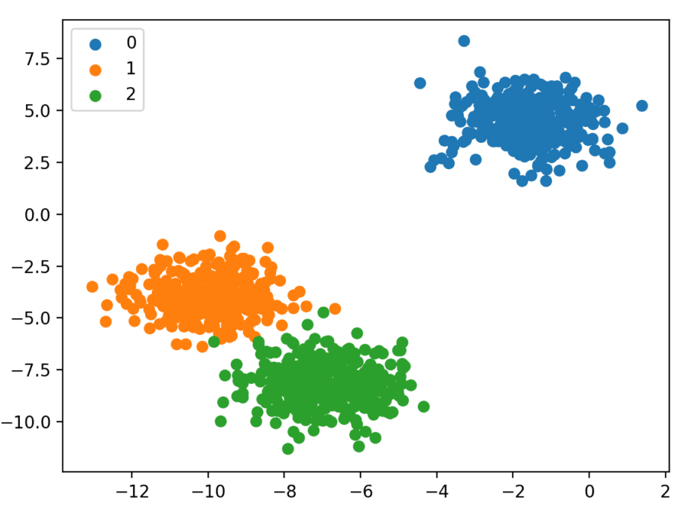
Initial Approach: Acoustic Embeddings
Example of Ideal Clustering Output
Concept & Objective
What: Mapping pressure vectors (24k*120 Matrix) to a lower-dimensional vector space where similar sounds cluster
Goal: Evaluate if embeddings provide clear separation between the presence vs. absence of fish calls.
Speech Models
Wav2Vec: Speech-biased
WavLM: Noise robust
AudioSet Models
OpenL3: Strong for bio-sounds
YAMNet: Strong for marine calls
Conclusion: None of the embeddings returned meaningful results for call separation
Notes:
Audioset is the

Slide 5
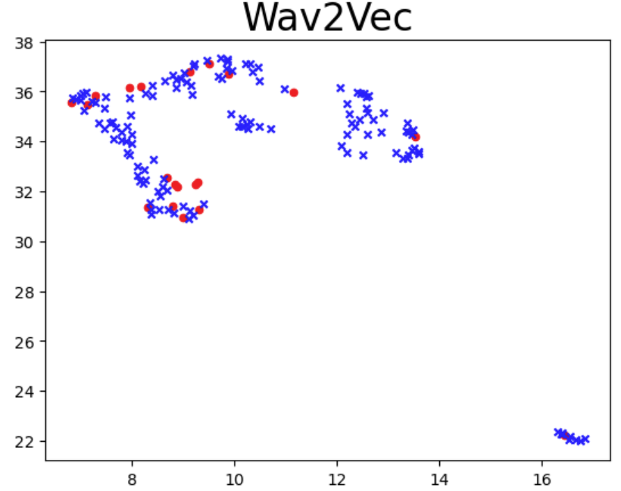
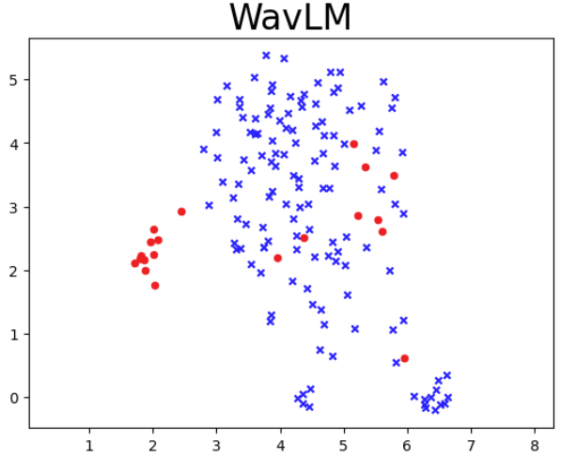
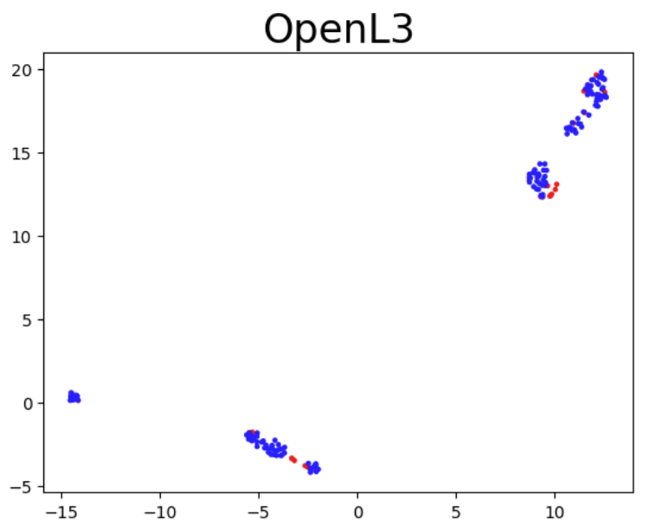
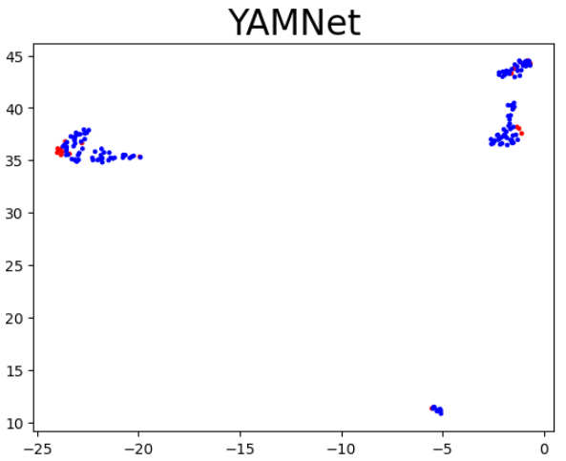
Notes:
Embeddings in many dim -> 2D MENTION THAT - umap

Slide 6

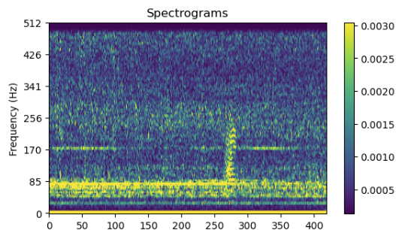
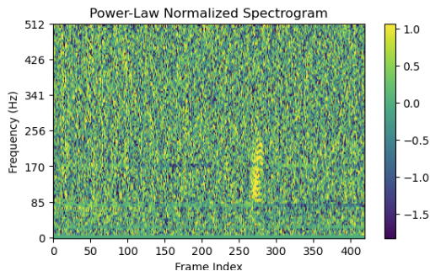
Secondary Approach: Power Law + Classifiers
Power Law Detector:
Often used to suppress background noise to identify whale calls
  Emphasizes unique events
We applied this to our downsampled (1024), whitened, and log transformed WAV files by using a local normalization method
Next, we took the energy sum
Source: T. A. Helble et al., "A generalized power-law detection algorithm for humpback whale vocalizations," J. Acoust. Soc. Am., vol. 131, no. 4, 2012.

Slide 7
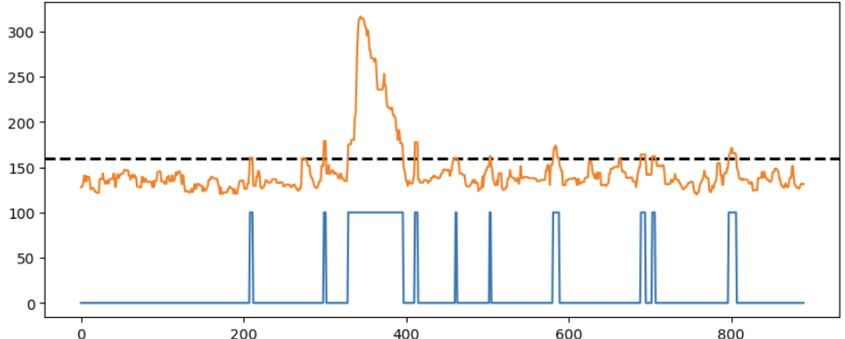
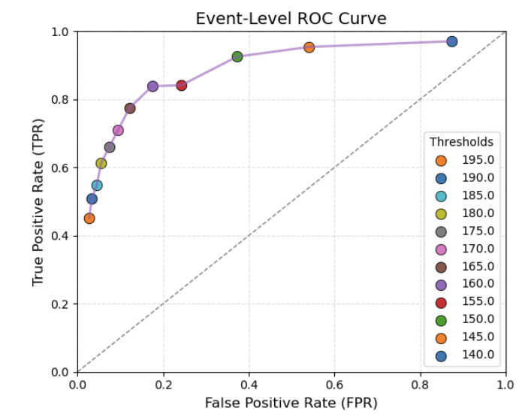
Binary Classifier/Detector
Binary Classifier (Blue Spike = Detection)
An initial filter before our true classification algorithm
  Decides what pieces of the Wav file we would like to further inspect
Receiver Operating Curve (ROC) - where chose to operate
  Best threshold → 160
  Here, the probability of a a mistake is ~20%, and the probability of a correct identification is above 80%

Slide 8
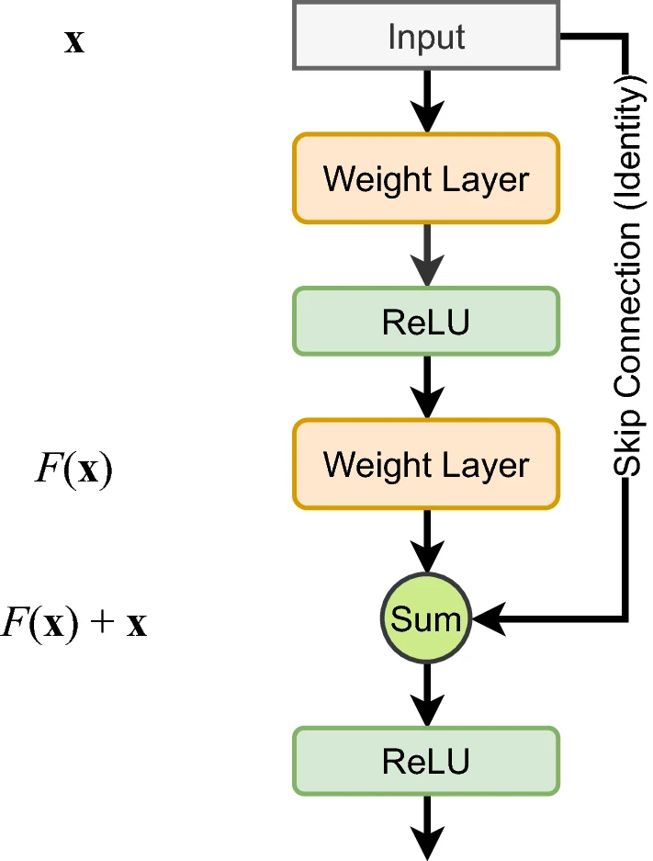
Multiclass Classifier
This is where our problem of few-shot came to light
Used a residual network to learn stable features
Pre‑trained on unlabeled data using temporary random labels
Applied augmentations to prevent overfitting
Fine‑tuned on the small labeled dataset
Residual Network Feature Mapping

Slide 9
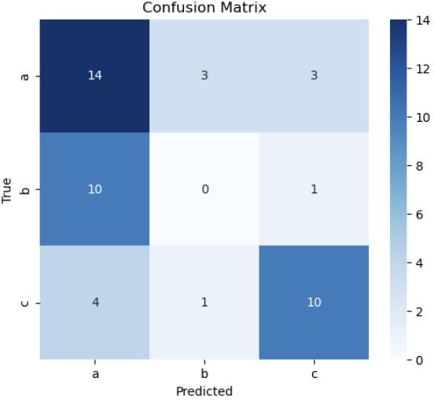
Results
The embedding method had poor performance, since classes were not easily separated
The power law detector helped bring out the unique low-frequency calls
The multi-class classifier was able to distinguish some classes, but confused others, likely due to differences in average call length
Multi-class Confusion Matrix

Slide 10
Conclusion
Few-shot event detection could be a feasible option for labeling in the near-future
More work is needed to create unsupervised methods for complex areas such as fish calls
Future fine-tuning is needed to help separate events of varying length
Note: This method still requires a lot of data, the key is it only requires a small amount of labeled data

Slide 11
Questions?
fmhuffma@mtu.edu
Student paper award feedback

